Slide 1
Online shopping application
Group 5 :
Mayssa elloumi
Maged Elbasyouny
Magdy Youakim
Salah mohamed

Slide 2
Project overview
The goal of our project is to create a comprehensive online shopping platform that offers Customers a quick and straightforward way to shop.
Users can explore, find, and buy products in a variety of website categories. The software would also facilitate order status tracking and user account management.

Slide 3
Project Scope:
1. User Registration and Authentication:
• Users can create accounts using email and password.
• Users can login and logout securely.
2. Product Catalog Management:
• Display products in various categories (e.g., Electronics, Fashion, Home Appliances).
• Search and filter products by name, category, price
• Detailed product Name, descriptions, images, and price.
3. Shopping Cart and Checkout:
• Add or remove products from the shopping cart.
• Update product quantities in the cart.
• Secure checkout process

Slide 4
4. Order Management:
• Track order status (e.g., Processing, Shipped, Delivered).
• View order history and details.
• Cancel orders.
5. User Account Management:
• View and update user profile information.
• Manage shipping addresses.
6. Admin Panel:
• Manage user accounts and roles.
• Manage product listings (add, edit, delete).
• Manage order status

Slide 5
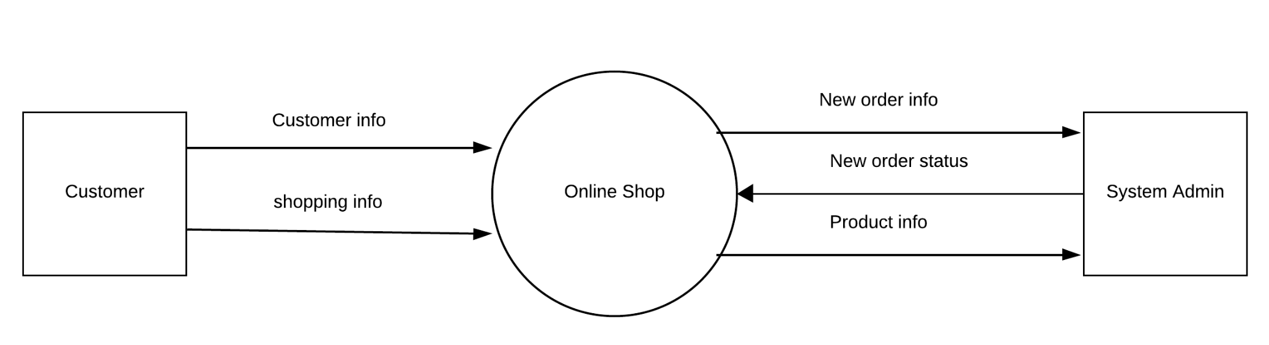
Context diagram:

Slide 6
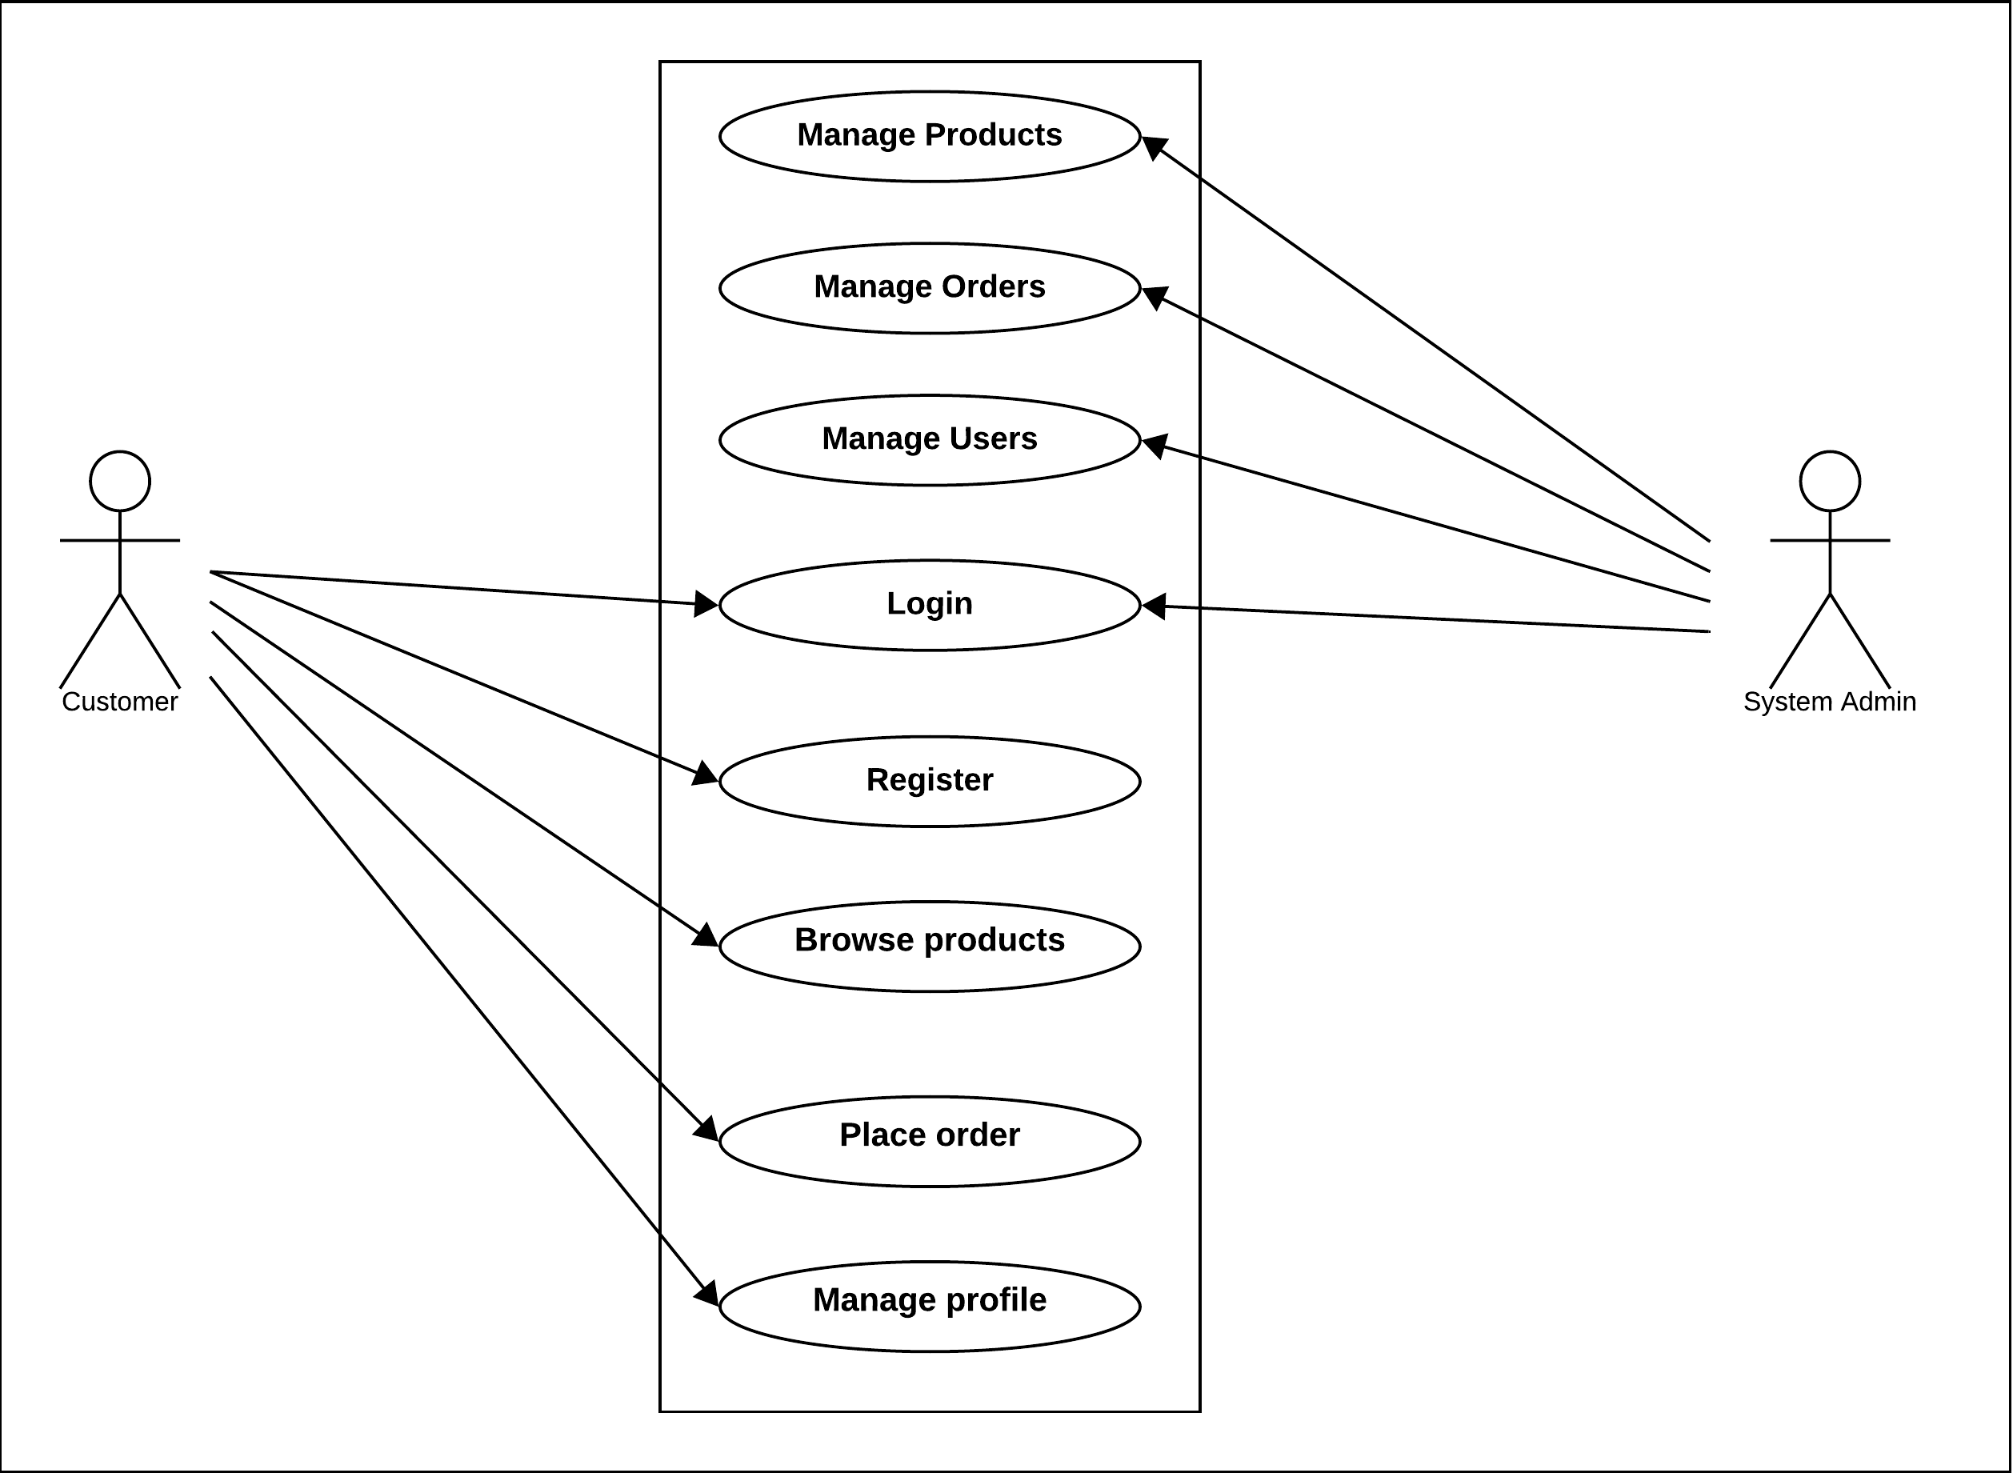
Use case diagram:

Slide 7
Main scenarios
User Registration
1. The customer navigates to the registration page.
2. The system displays the registration form.
3. The customer fills in the required information (email, password).
4. The customer submits the registration form.
5. The system validates the input data (best scenario).
6. The system verifies the email address and activates the user's account.
7. The system displays a confirmation message that the registration is successful.

Slide 8
Login
1. The customer navigates to the login page.
2. The system displays the login form.
3. The customer enters their email and password.
4. The customer submits the login form.
5. The system validates the credentials.
6. The customer is successfully logged in.
7. the system navigates the user to the home page.

Slide 9
Place Order
1. The customer browses the products and adds desired items to the shopping cart.
2. The customer navigates to the shopping cart to review the items.
3. The system displays the items in the cart along with the total price.
4. The customer clicks on the 'Proceed to Checkout' button.
5. The system displays the checkout page with fields for shipping details and payment information.
6. The customer fills in the shipping details and selects the payment method.
7. The customer submits the order.
8. The system validates the order details and payment information.
9. The system generates an order confirmation and sends an email with the order details to the customer.
10. The customer receives the order confirmation, and the order is recorded in the system.

Slide 10
Acceptance criteria
User Registration:
1. Navigation to Registration Page:
• When the customer navigates to the registration page URL, the system should display the registration form.
2. Display of Registration Form:
• The registration form must be displayed with fields for email and password.
3. Filling Required Information:
• The customer must fill in the email and password fields with valid formats.
• The password must meet specified complexity requirements (e.g., minimum length, inclusion of special characters).

Slide 11
4. Form Submission:
• When the customer submits the registration form, the system must capture the entered data.
5. Validation of Input Data:
• The system must validate that the email is in the correct format and not already in use.
• The password must meet the complexity requirements.
• If any validation fails, the system must display appropriate error messages.
6. Successful Registration Confirmation:
• Once the account is activated, the system must display a confirmation message indicating that the registration is successful.

Slide 12
Login:
1. Navigation to Login Page:
• When the customer navigates to the login page URL, the system should display the login form.
2. Display of Login Form:
• The login form must be displayed with fields for email and password.
3. Entering Email and Password:
• The customer must enter a valid email and password combination.
4. Form Submission:
• When the customer submits the login form, the system must capture the credentials entered.

Slide 13
5. Validation of Credentials:
• The system must verify that the email and password match a registered user.
• If the credentials are invalid, the system must display an appropriate error message.
6. Successful Login:
• Upon successful validation, the customer must be logged in.
7. Navigation to Home Page:
• The system must navigate the logged-in customer to the home page.

Slide 14
Place Order:
1. Adding Items to Shopping Cart:
• The user must be able to browse products and add items to the shopping cart. • The system must update the cart to reflect the added items.
2. Navigation to Shopping Cart:
• When the user clicks on the cart icon or link, the system must navigate to the shopping cart page.
3. Display of Cart Items:
• The system must display all items in the cart along with the total price.
4. Proceed to Checkout:
• When the user clicks the 'Proceed to Checkout' button, the system must navigate to the checkout page.

Slide 15
5. Display of Checkout Page:
• The checkout page must display fields for shipping details and payment information.
6. Filling Shipping Details and Payment Method:
• The user must be able to fill in the shipping details and select a payment method.
7. Order Submission:
• When the user submits the order, the system must capture all order details.
8. Validation of Order Details and Payment:
• The system must validate the shipping details and payment information.
• If any validation fails, the system must display appropriate error messages.

Slide 16
9. Order Confirmation and Email:
• Upon successful validation, the system must generate an order confirmation.
• The system must send an email with the order details to the user.
10. Order Recording:
• The system must record the order in the database.
• The user must receive the order confirmation email.

Slide 17
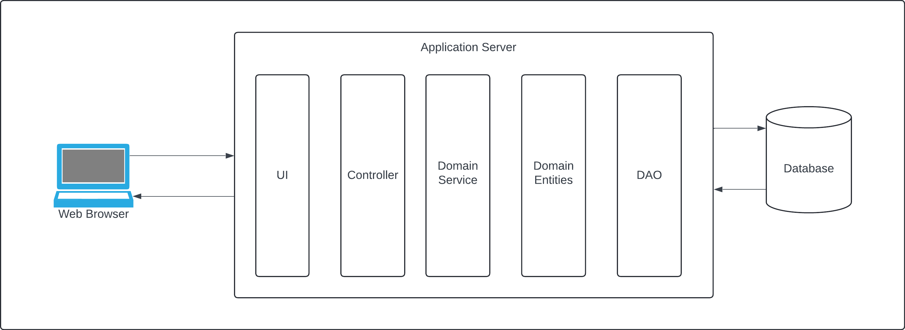
Solution architecture

Slide 18
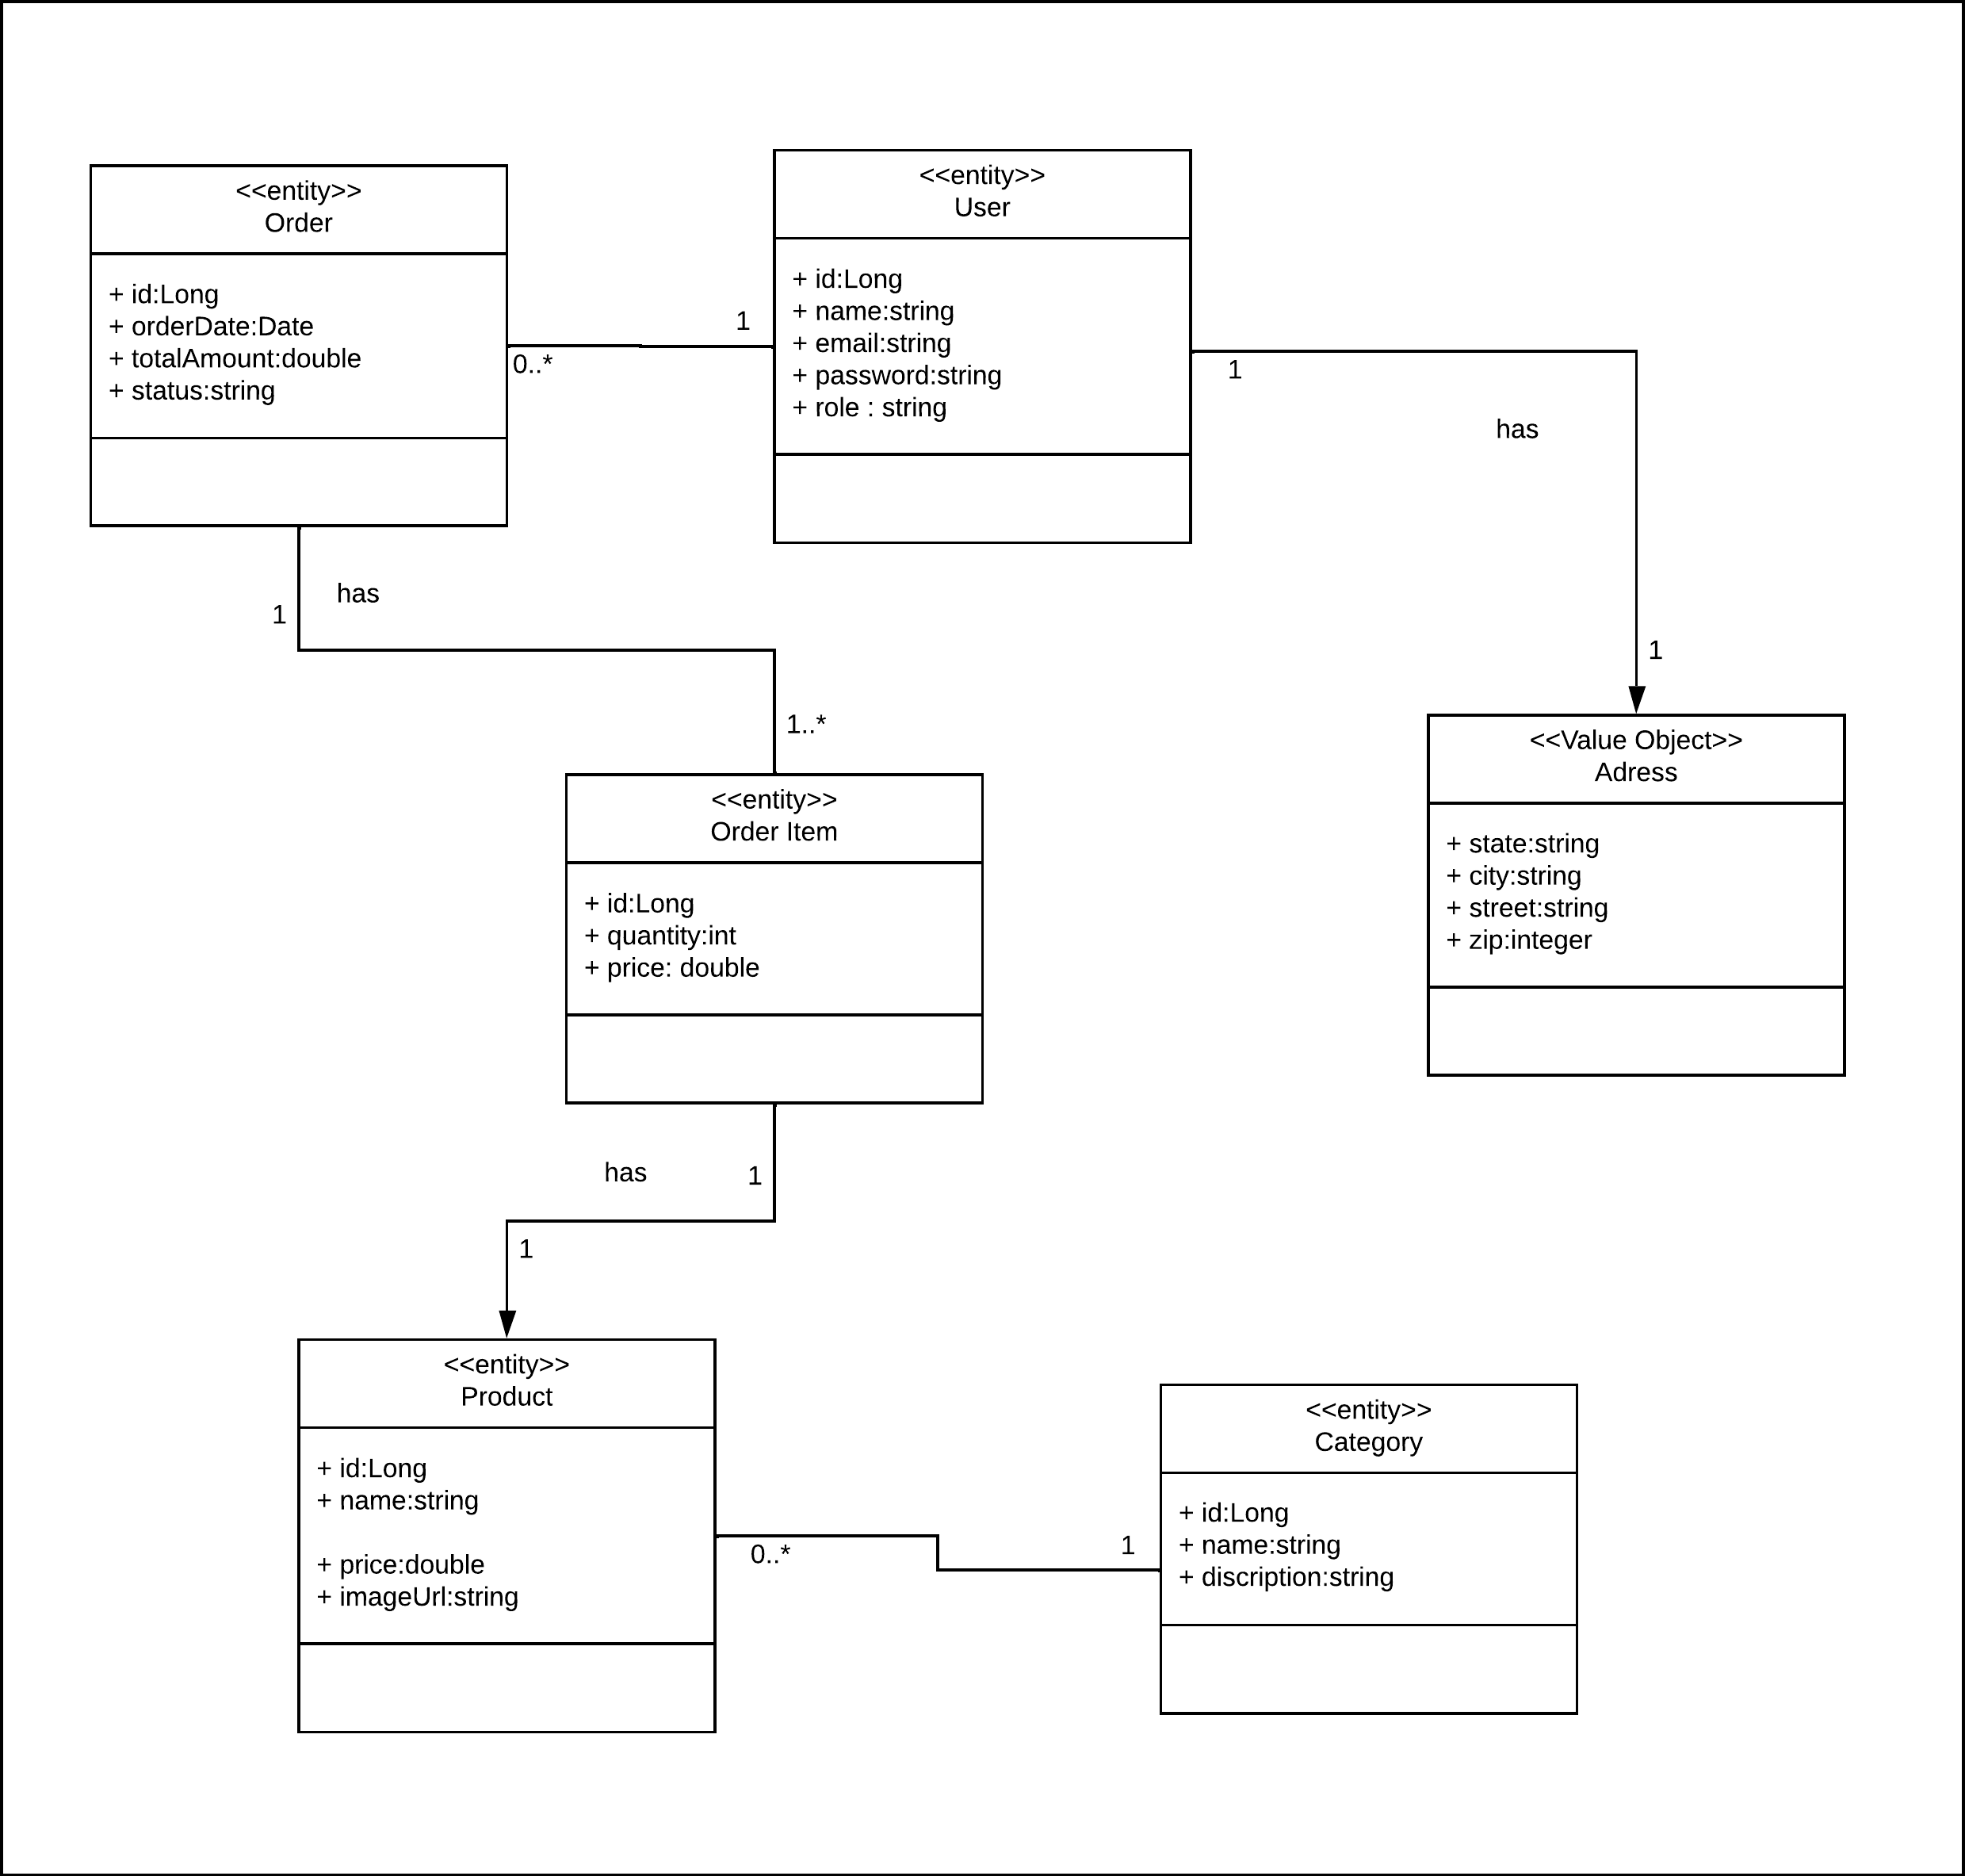
Class diagram:

Slide 19
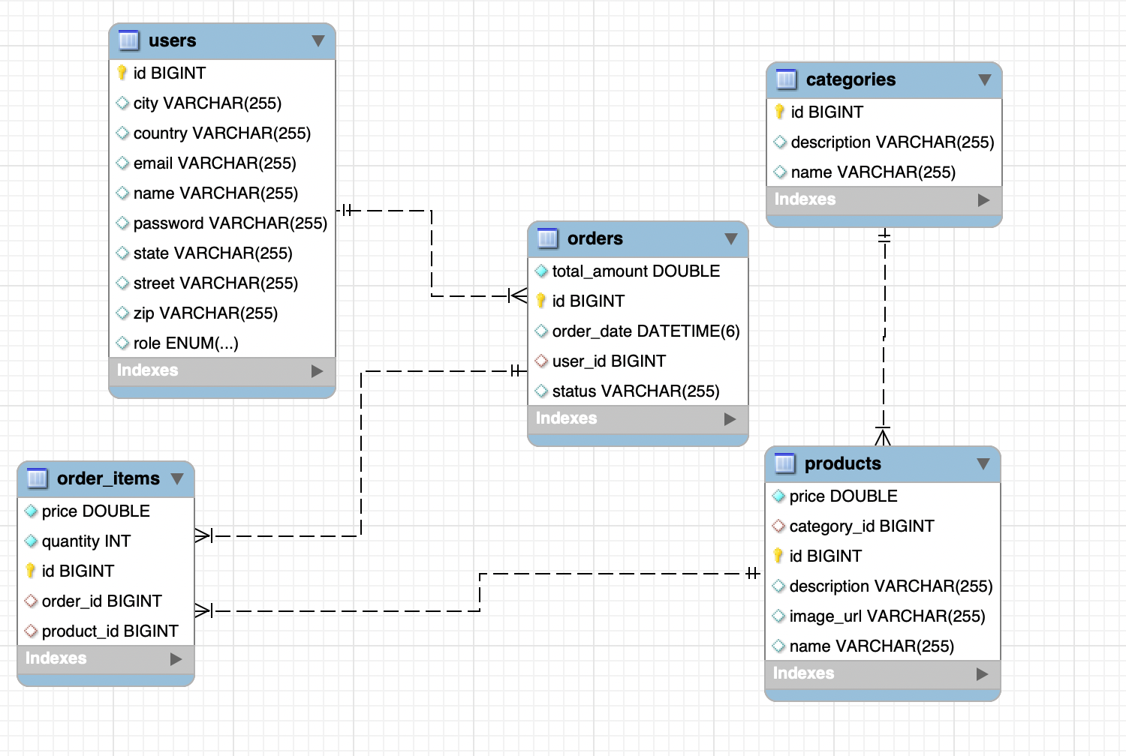
ER diagram

